Slide 1


Slide 2
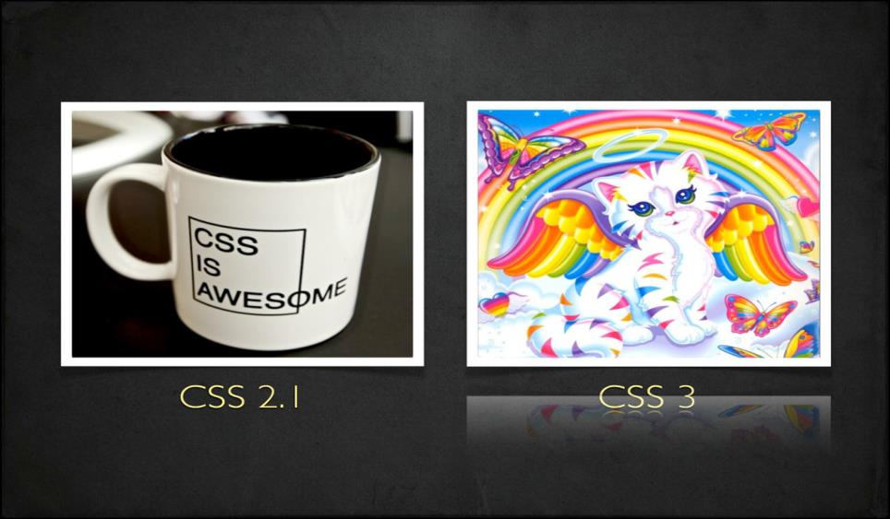

Slide 3
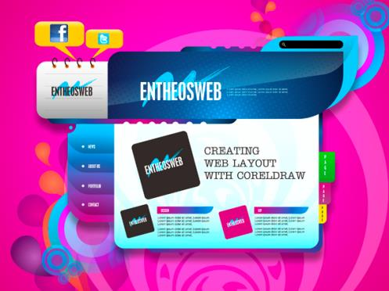
Good Speed
Work on my phone
Wow, 3D animation!
New Fonts
Multiple browser support
Colorful
Unbelievable
What they see

Slide 4
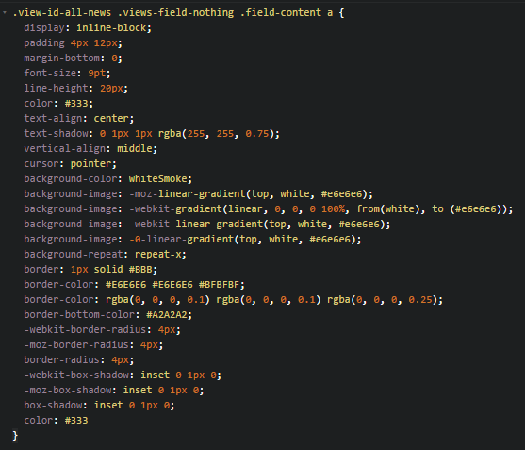

What we see
Too complex, too long
Difficult to maintain
What if customer want to change a color in project?
Ctrl + R => replace all?

Slide 5
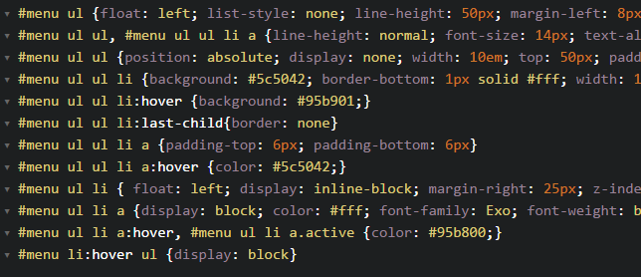
Dupplicate, hard to read

Slide 6
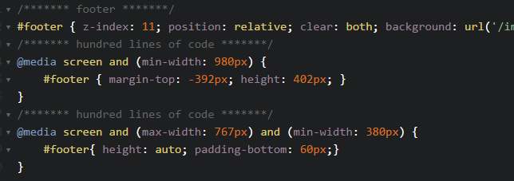
Waste of time

Slide 7
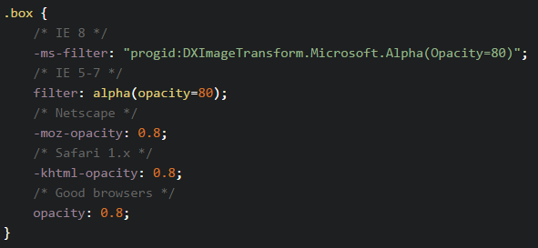
Hard to implement

Slide 8
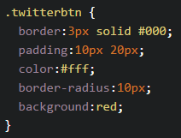
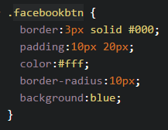
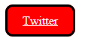
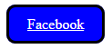
No re-use, just copy & paste

Slide 9
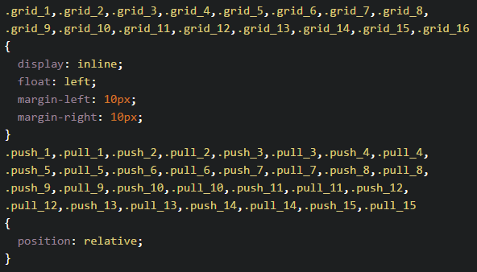
Oh my god, no looping function

Slide 10
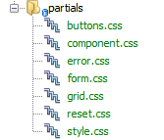
Separate CSS are good enough?
=> HTTP requests problem

Slide 11
What we need?
Easy to change/maintain => Variable
Easy to read => Nesting
Easy to write => Mixins
No duplicate, reusable code => Extend/Inheritance
Easy to organize, fewer Reqs => Partials, Import
Powerful => Operators, Condition, Loop

Slide 12

Introduction to

Slide 13
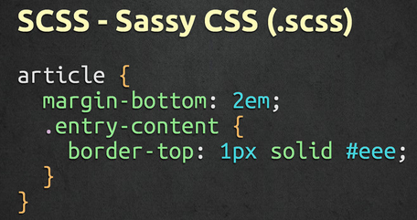
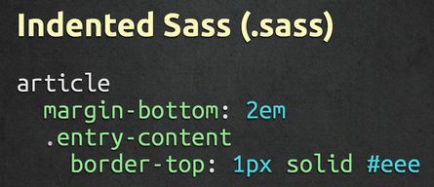
What is Sass
Syntactically Awesome StyleSheets
Simple but powerful syntax for creating manageable CSS
Too “flavors” – SASS & SCSS

Slide 14
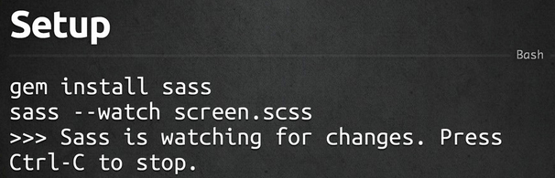
How to install

Slide 15
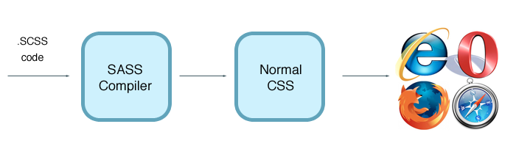
Sass work flow

Slide 16


Slide 17
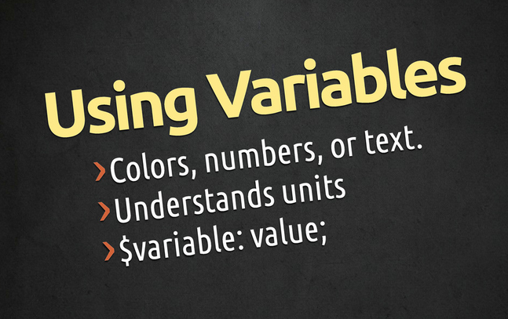

Slide 18
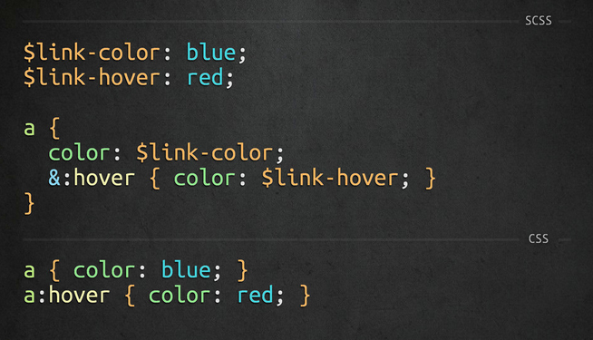

Slide 19


Slide 20
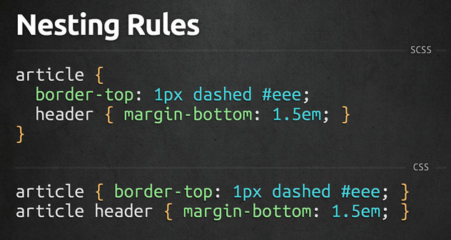

Slide 21
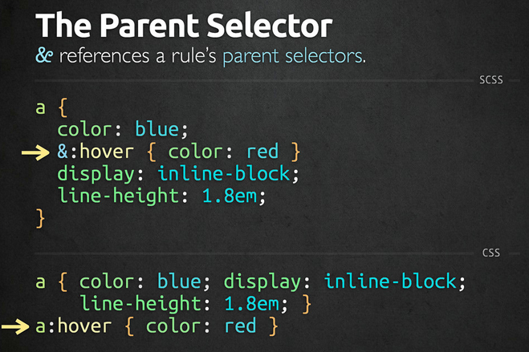

Slide 22
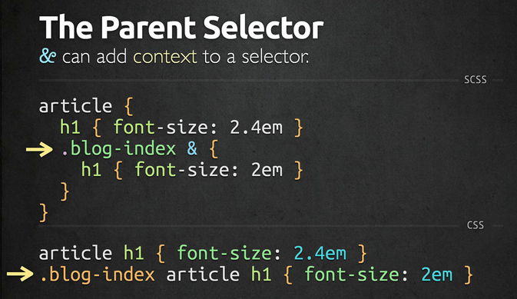

Slide 23
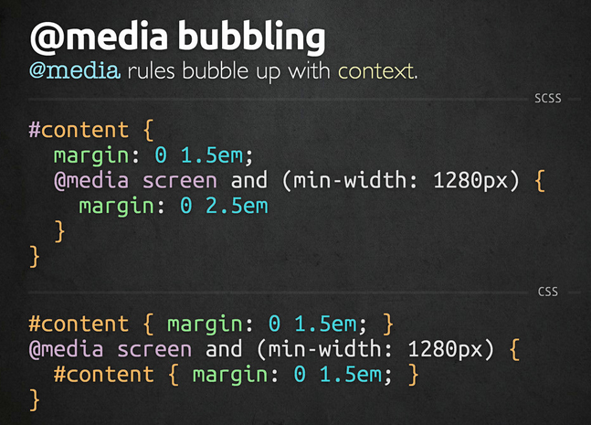

Slide 24


Slide 25
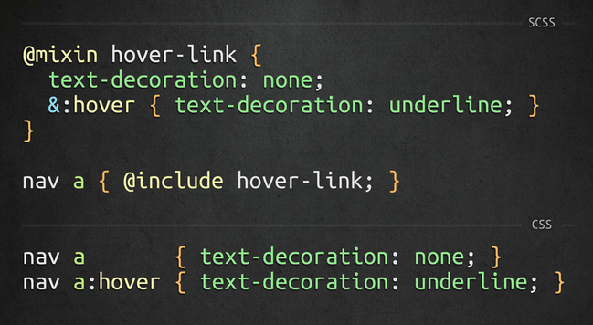

Slide 26
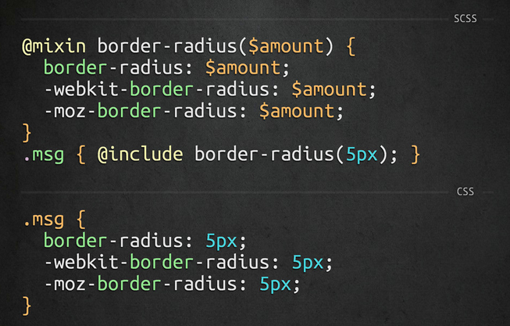

Slide 27
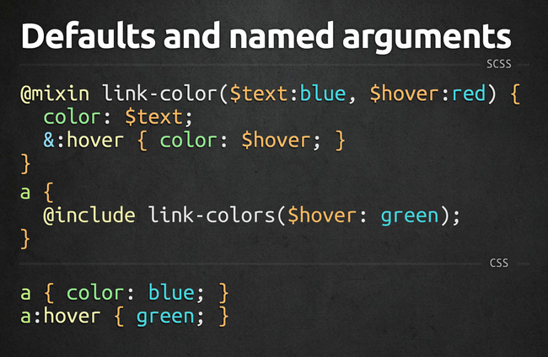

Slide 28


Slide 29
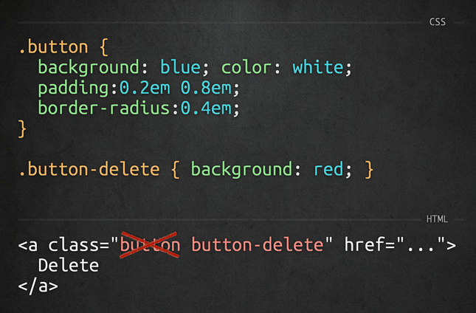

Slide 30
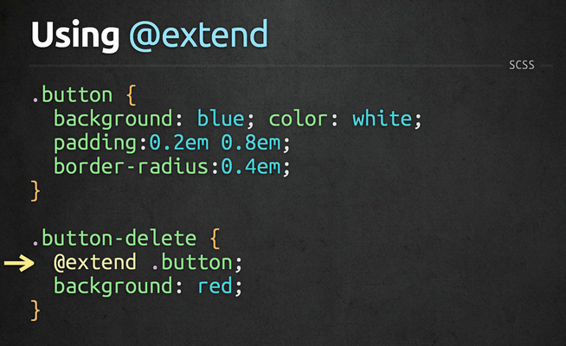

Slide 31
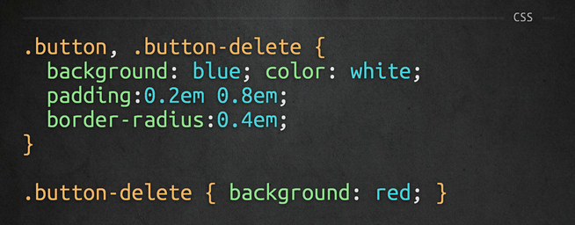

Slide 32


Slide 33
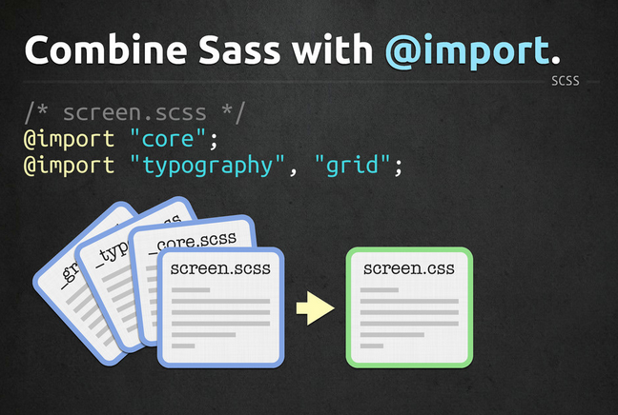

Slide 34
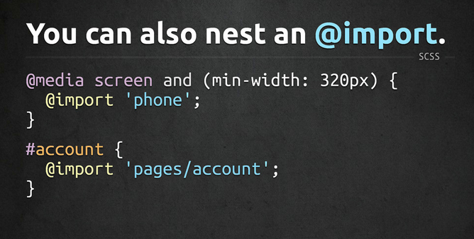

Slide 35


Slide 36
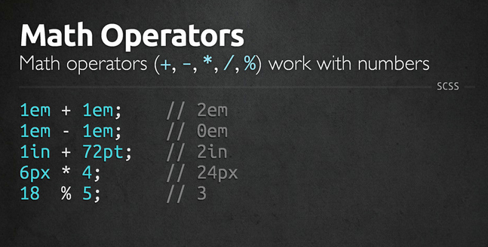

Slide 37
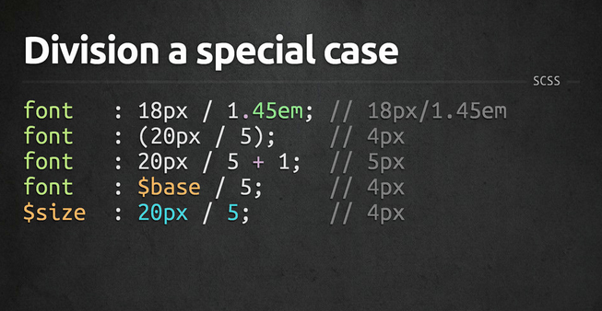

Slide 38
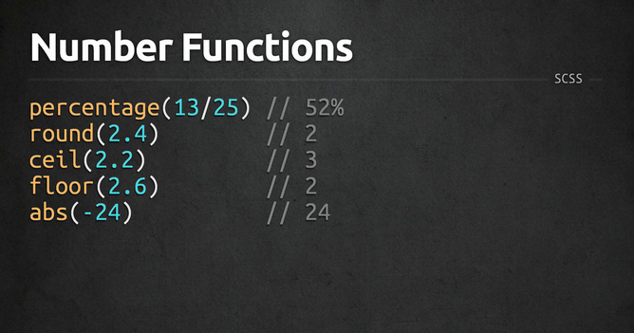

Slide 39
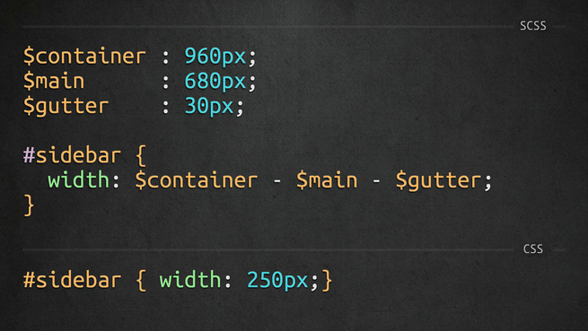

Slide 40


Slide 41


Slide 42
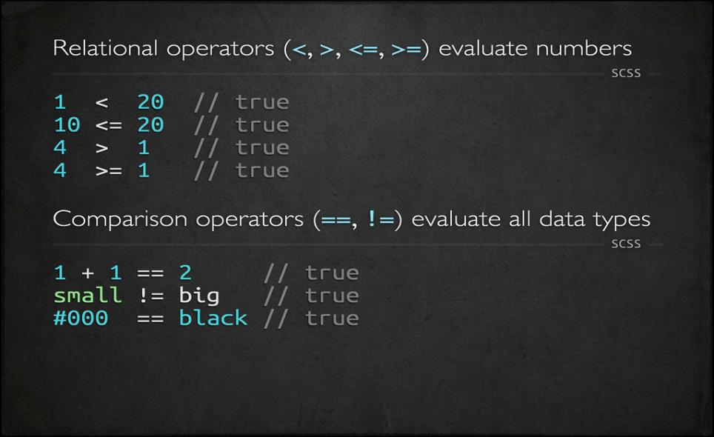

Slide 43
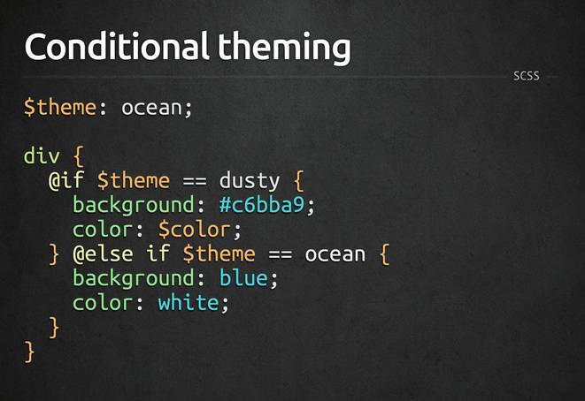

Slide 44
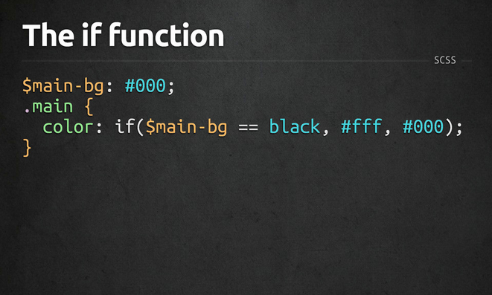

Slide 45
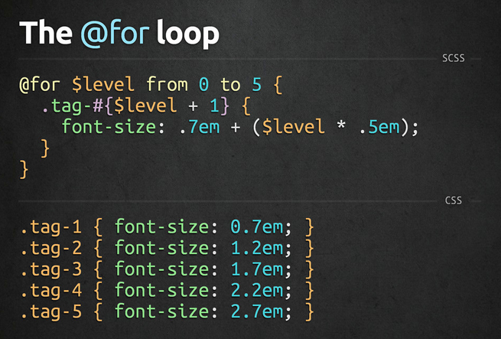

Slide 46
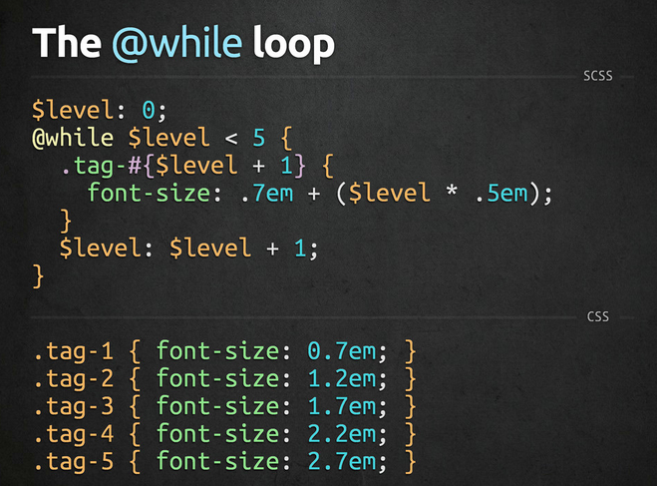

Slide 47
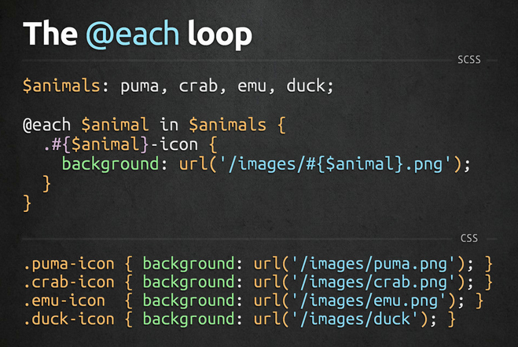

Slide 48


Slide 49
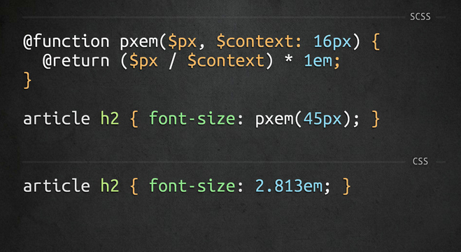

Slide 50

Introduction to
Notes:
http://compass-style.org/reference/compass/css3/

Slide 51
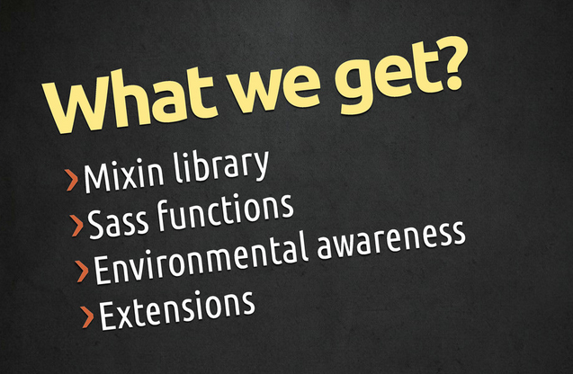

Slide 52
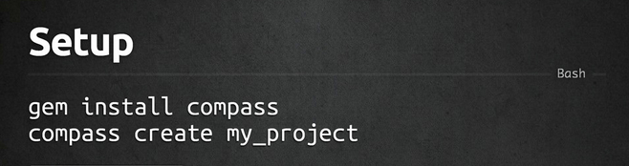
How to install

Slide 53
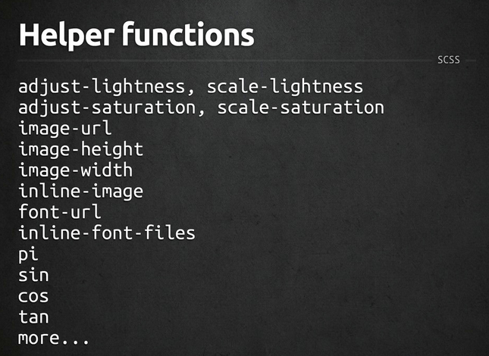

Slide 54
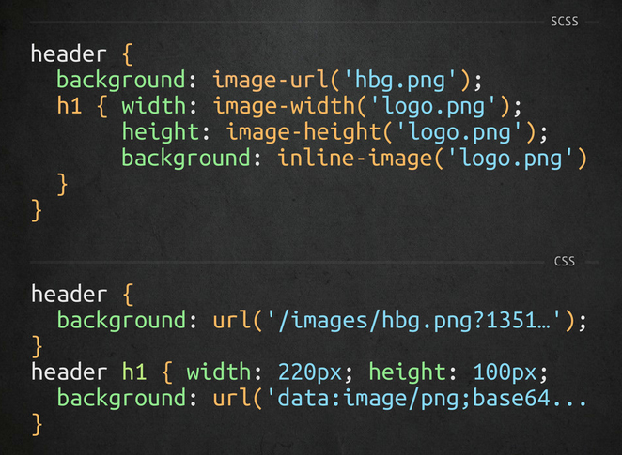

Slide 55
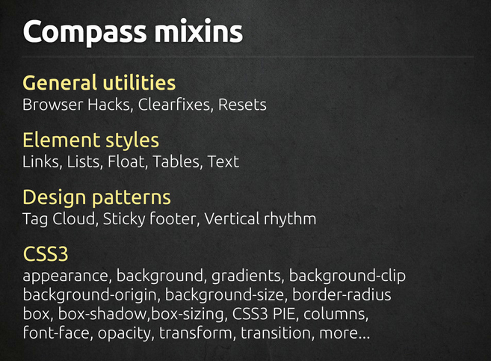

Slide 56
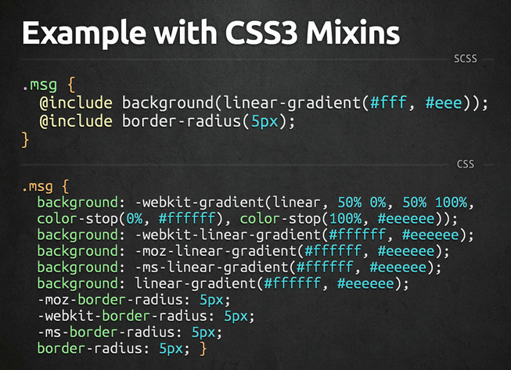

Slide 57
Disadvantages
Not for beginners:
Need basic CSS, time to understand SASS
Need basic programming knowledge (problem for designer)
Need installation/environment setup
Need time to compile
A little bit hard to debug
Can’t edit on live server (nah, you shouldn’t do that)

Slide 58
Sass Tools
Prepros
Livereload
Hammer
Koala
Scout
Bourbon

Slide 59
Sass Tools
Compile SASS to CSS
Add mixins, functions, helpers
Add compass, autoPrefix, SourceMaps
Output style: Compressed, Compact, Nested, Expended

Slide 60
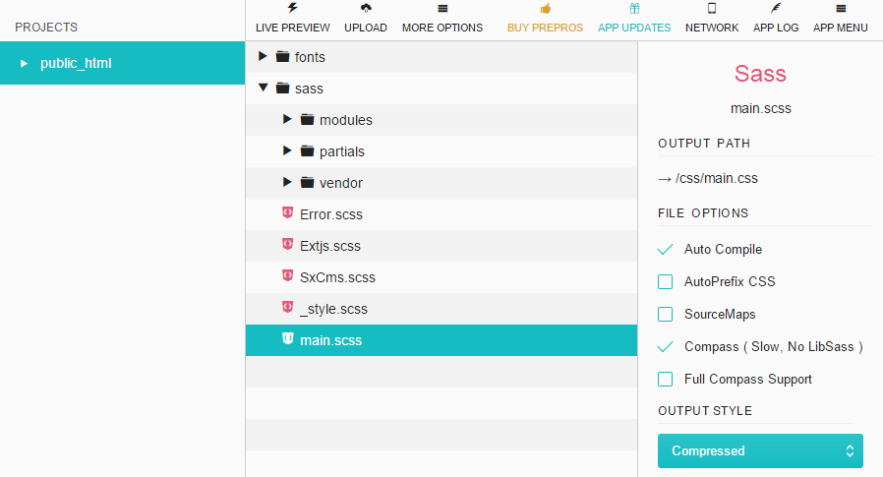

Slide 61
THANK YOU FOR YOUR ATTENTION!

